Slide 1
VIRTUAL GENIE
YOUR WISH IS WINDOWS COMMAND

Slide 2
FINAL PPT
ABSTRACT
EXISTING SYSTEM
PROPOSED SYSTEM
ARCHITECTURE
HARDWARE & SOFTWARE REQUIREMENTS
MODULE DESCRIPTION
UML DIAGRAM
SCREENSHOTS
TESTING
CONCLUSION
FUTURE ENHANCEMENT

Slide 3
ABSTRACT
Summary:
In a world where technology increasingly blends with our daily lives, the desire for seamless and intuitive interactions with our devices grows stronger. "Virtual Genie" answers this call, offering a comprehensive voice-controlled automation solution designed to transform the Windows experience. Harnessing the power of AI and natural language processing, Virtual Genie empowers users to control virtually every aspect of their Windows environment with the effortless ease of spoken commands.
Application: Key features and capabilities of Virtual Genie include:
Voice-First Interaction: Navigate and control Windows seamlessly using natural language commands, eliminating the need for traditional input methods.
Secure Access: Protect user privacy and data with secure login, ensuring only authorized individuals can access its features.
Comprehensive Control: Access and manage a wide range of Windows functions, including:
Opening applications
Working with files and folders
Writing text
Using speech-to-text
Adjusting settings (Bluetooth, Wi-Fi, etc.)
Accessing information online (Wikipedia, browsing)
Customizing commands with "add newCmd"
And more

Slide 4
Outcome: Virtual Genie aims to:
Revolutionize Windows Interaction: Redefine how users interact with their computers, offering a hands-free, voice-driven experience that enhances efficiency and accessibility.
Maximize Productivity: Streamline workflows, reduce manual actions, and free up time for more meaningful tasks, leading to heightened productivity and task completion.
Empower Users of All Abilities: Grant individuals with physical limitations or those who prefer voice-based interaction a more accessible and empowering way to control their Windows environment.
Unlock New Possibilities: Foster innovation in voice-controlled technology, paving the way for even more transformative applications in the future.

Slide 5
EXISTING SYSTEM
While "Virtual Genie: Your Wish Windows Command" offers a unique approach using natural language understanding, several existing systems provide voice-activated command functionalities on Windows, each with its own strengths and limitations:
1. Windows Command Prompt and PowerShell:
Strengths:
- Built-in, readily available on all Windows systems.
- Offer powerful scripting capabilities for advanced users.
- Extensive documentation and online resources available.
Limitations:
- Require technical knowledge and expertise.
- Not user-friendly for non-technical users.
- Limited natural language understanding (requires specific commands).

Slide 6
2. Microsoft Power Automate:
Strengths:
- Visually-driven interface simplifies automation creation.
- Integrates with various apps and services, including Windows applications.
- Cloud-based platform for easy accessibility.
Limitations:
- Primarily focused on workflow automation, not direct command execution.
- May require some technical knowledge for complex tasks.
- Free plan has limited features and usage quotas.

Slide 7
3. Third-Party Tools:
Strengths:
- Wide variety of options with different features and functionalities.
- Some offer more natural language understanding than Windows tools.
- Can be tailored to specific use cases.
Limitations:
- Vary in quality and reliability.
- Some may require paid subscriptions or downloads.
- Security and privacy concerns might exist with certain tools.

Slide 8
PROPOSED SYSTEM
Natural Language Understanding (NLU): Enables users to express wishes using plain English commands, making the system accessible to a wider audience.
Intent Recognition: Identifies the user's desired action or outcome behind the command, facilitating context-aware responses.
Task Automation: Automates routine tasks based on user wishes, minimizing manual effort and increasing efficiency.
Personalization: Learns user preferences and tailors responses and automation actions accordingly, enhancing user experience.
Customization: Allows users to define custom commands and actions for specific use cases, expanding system capabilities.
Error Handling and Feedback: Provides informative error messages and suggestions for incorrect or unsupported wishes, guiding users toward successful interactions.

Slide 9
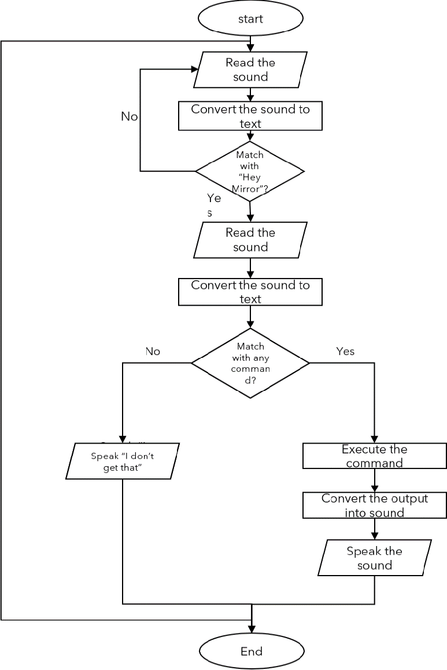
SYSTEM ARCHITECTURE

Slide 10
HARDWARE AND SOFTWARE REQUIREDMENTS
Hardware:
Modern computer with at least 4 GB RAM and 2 GHz processor (preferably 8 GB RAM and 3 GHz CPU for optimal performance).
Stable internet connection for downloading necessary dependencies and accessing cloud-based features (if applicable).
SOFTWARE : Python 3.8 or later. Required Python libraries:
`nltk` for natural language processing
`spaCy` for advanced NLU and text analysis
`pyttsx3` for text-to-speech functionalities
`keyboard` for simulating keyboard interactions
`pyautogui` for automating mouse and GUI interactions

Slide 11
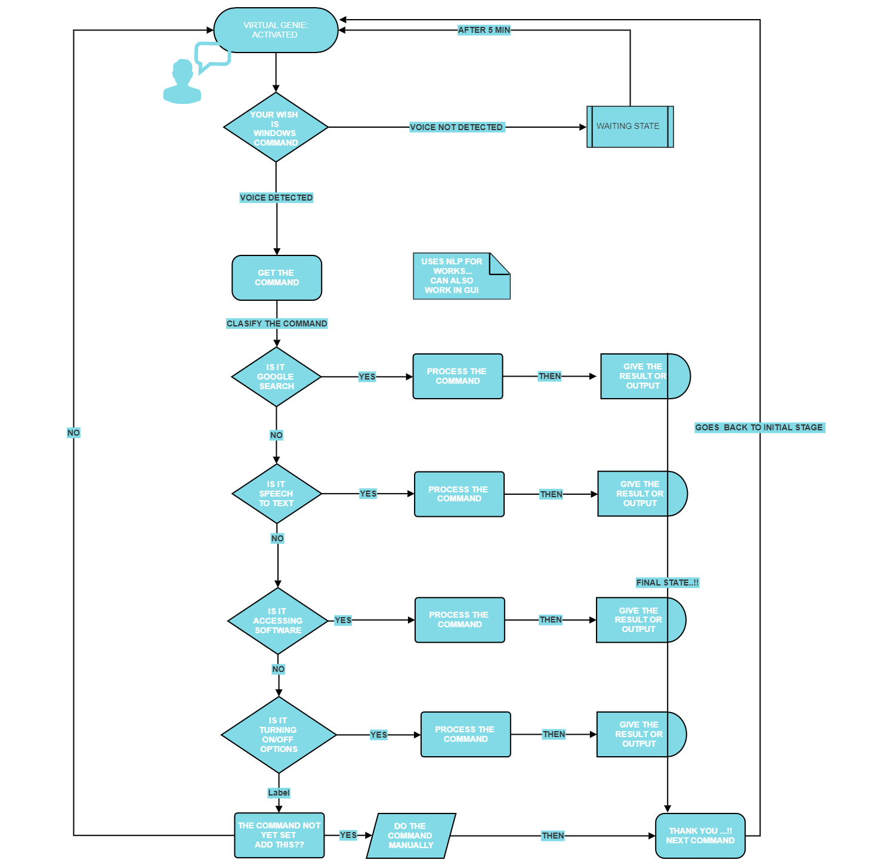
UML DIAGRAM

Slide 12
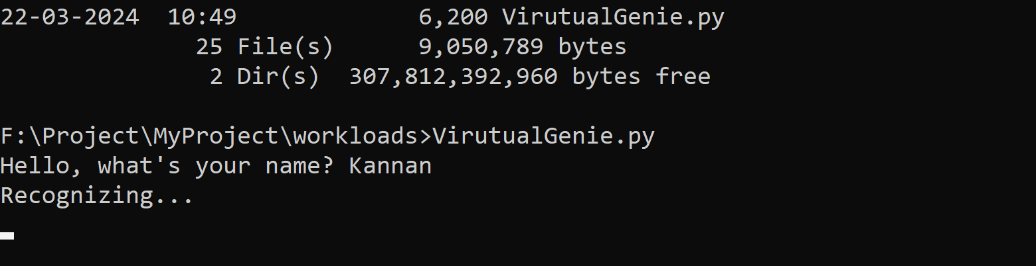
SCREENSHOTS
INITIAL Start Up and Running
-→OUR PROGRAM FILE
=>Waiting for speech Input

Slide 13
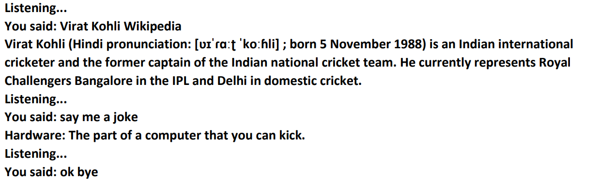
SCREENSHOTS

Slide 14
CONCLUSION
Virtual Genie represents a potential future for AI-powered tools capable of generating interactive, controllable virtual environments based on user prompts. This technology holds promise for various applications, including:
Educational experiences: Learners could explore virtual simulations of historical events, scientific phenomena, or complex systems for a more immersive learning experience.
Entertainment: Users could create and explore personalized virtual worlds for games, recreation, or relaxation.
Prototyping and design: Virtual Genie could be used to generate and test prototypes of physical products or environments, streamlining the design process.
However, the development of Virtual Genie is in its early stages.

Slide 15
FUTURE ENHANCEMENT
The concept of Virtual Genie, an AI that crafts interactive and controllable virtual environments based on user prompts, holds immense potential. Here's a glimpse into some exciting future enhancements:
Emotional Intelligence: Virtual Genies could understand and respond to user emotions, tailoring the experience accordingly. They could offer comfort, encouragement, or adjust the environment's mood based on user needs.
Educational A.I. Tutors: Virtual Genies could become personalized A.I. tutors, creating interactive lessons and simulations tailored to individual learning styles

